Slide 1

Exploratory Data Analysis -Breast Cancer Data

Slide 2
Analysis based on these Questions
w many women were survived less than 5 years and how many more than 5years? How many women were survived less and how many more than 5years?How many women were survived less than 5 years and how many more than 5years?
How many women were survived less than 5 years and how many more than 5years? Was the survival impacted with Age and cancer stage?
Was the survival impacted with different cancer stage?
Was there any impact of number of Pos_axillary_nodes on the survival status for different ages?
Was there any difference in Success rate as per year of operation ?
Conclusions survival impacted with Age and cancer stage?

Slide 3
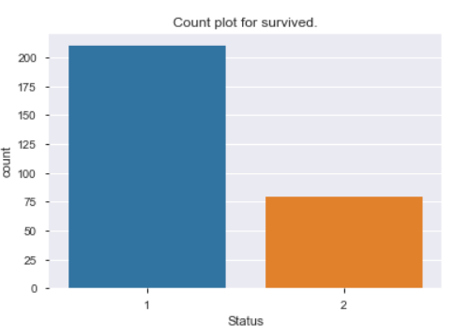
How many women were survived less than 5 years and how many more than 5years?
210 women were survived more than 5 years and 79 women were survived less than 5years.

Slide 4
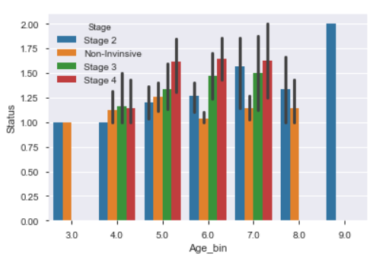
Was the survival impacted with Age and cancer stage?
Most impacted age of cancer is 41 - 60 and mostly impacted by stage 4 cancer.
Non-Invasive can be happened at any age of women.

Slide 5
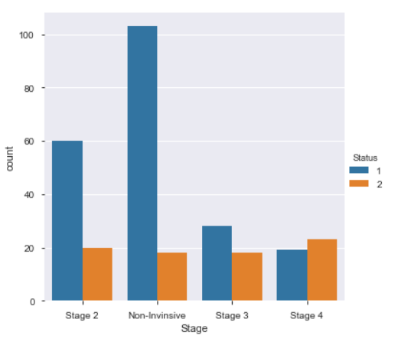
Was the survival impacted with different cancer stage?
We can see that most of the women were survived more than 5years for Non-Invasive type of cancer.

Slide 6
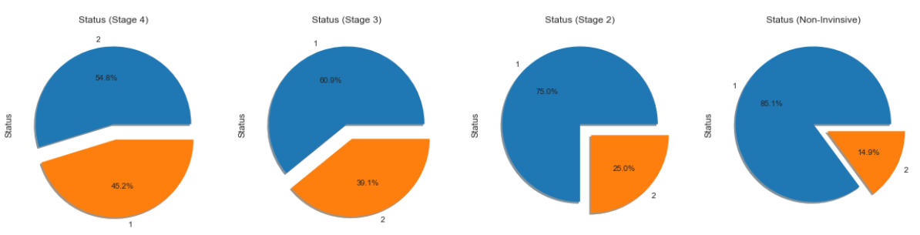
Was the survival impacted with different cancer stage?
We can see that for Stage 4 cancer chances of survival and death is approximately 50%.

Slide 7
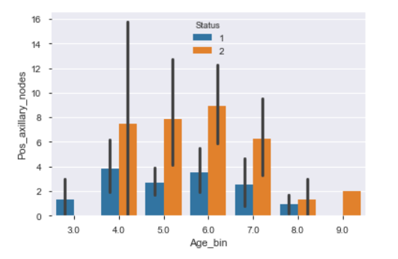
Was there any impact of number of Pos_axillary_nodes on the survival status for different ages?
There is very high chance, with the increase of age, cancer can spread to more lymph nodes and leads to less survival rate.

Slide 8
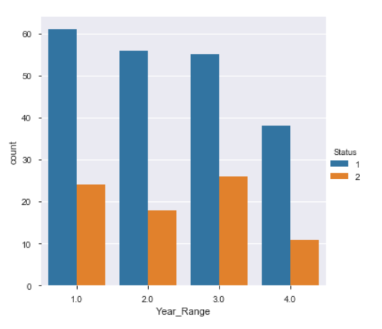
Was there any difference in Success rate as per year of operation ?
Year_Range1 - >1958 to 1960
Year_Range2 - >1961 to 1963
Year_Range3 - >1964 to 1966
Year_Range4 - >1967 to 1970
If we compare status1 and Status2 individually for each of the Year_Range, Year_Range 4 has status1 is 3.5 times more than status2.

Slide 9
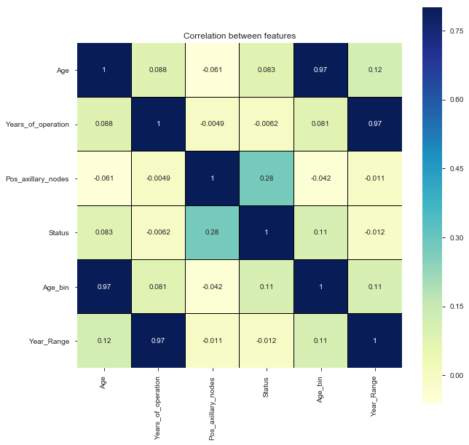
Conclusions
This exploratory data analysis helps us to understand chances of women to get diagnosed with Breast cancer with ages and how survival is getting impacted with number of positive axillary nodes.
The dataset contains 306 cases from a study that was conducted between 1958 and 1970 at the University of Chicago's Billings Hospital on the survival of patients who had undergone surgery for breast cancer.
From the analysis, it was concluded that, there is very high chance, with the increase of age cancer can spread to more lymph nodes and leads to less survival rate.
Women have be very careful and consult with doctor to know about the prevention of this cancer. As prevention is always better than cure .

Slide 10
Thank You !!

